Slide 1


Azure Synapse
Delta Lake - Spark, Serverless, SQL Pools & Beyond
Hiram Fleitas
Senior Customer Engineer, Data & AI

Slide 2
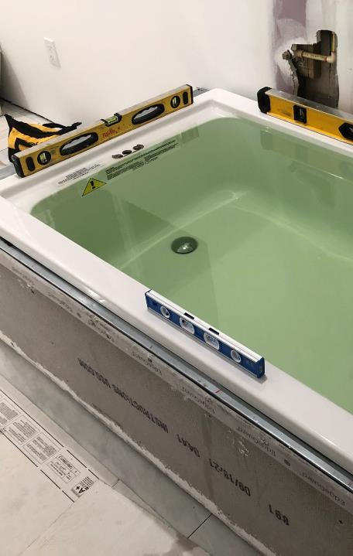
Machine Learning
Synapse Analytics
Power Platform
DevOps
About Me
aka.ms/hiram

Slide 3
Objective
I have a big data transactional CDC (change data capture) workload in delta format. This is very common in Databricks, but how does it work on Synapse?
Why? Because you can and you'd like to host/join/index your data in a static-layer to serve n-Number of queries.

Slide 4
What is Azure Synapse?
Limitless analytics service includes:
Data Integration
Enterprise data warehousing
Big data analytics
Provides unified experience to:
Ingest
Explore
Prepare
Manage
Serve
Business Intelligence
Machine Learning
Ref: aka.ms/azuresynapse

Slide 5
What is Synapse Spark?
In-memory parallel processing framework for big data analytics.
One of Microsoft’s implementation of Apache Spark.
How does it differ?
A config/definition of what you want a Spark Instance to look like.
Is an Azure Resource
Looks like a Spark Cluster to clients
Is Free (when not being used to run a workload)
Provides isolation and budget control
Can be managed from Azure Portal or Synapse Studio
Is securable
Can have additional libraries installed, different libs on different pools
Can be auto scaled or statically defined
Is NOT a cluster
Ref: docs.microsoft.com/azure/synapse-analytics/spark/apache-spark-overview

Slide 6
What is Delta format?
OSS storage layer for Spark
Provides:
ACID transactions (atomicity, consistency, isolation, and durability)
History of changes
Time travel in data history
Schema evolution
Optimizations:
Z-Ordering: co-locates related info in the same set of files
Bin-Packaging (Compaction): OPTIMIZE command to coalesce small files into larger files.
VACCUM: cleanup old compacted files
Ref: docs.microsoft.com/azure/synapse-analytics/spark/apache-spark-what-is-delta-lake#key-features
Notes:
Ref: https://youtu.be/8-mdnw_L91Y
INTERNAL:
https://microsoft.sharepoint.com/:p:/r/teams/DataAIInsider70/_layouts/15/doc2.aspx?sourcedoc=%7B4B387D17-781C-4C20-9338-0EC74B605279%7D&file=Introduction%20to%20Apache%20Spark%20on%20Synapse.pptx&action=edit&mobileredirect=true&DefaultItemOpen=1&cid=3c6e3b45-cefa-4c0d-ae4e-69c9e48a454b
Delta is a specific format. If know some of the challenges when dealing with GPDR and updates in big data systems. Its incredibly hard to do, its even harder to do well and in a consistent way that auditors will sign off on.
Databricks introduced this format which is based on parquet which is the default format for the lake these days, and actually spark’s default format although it’s switching to delta now.
Delta gives you basic transactional capabilities over the top of parquet, so the transactions are tracked and the transactions are applied.
One of the most important features is time travel (ie. versionAsOf), you can ask for the dataset by time or by transaction id.

Slide 7
Intro
Spark
Serverless
Pipeline
SQL Pools
Resources
Agenda

Slide 8
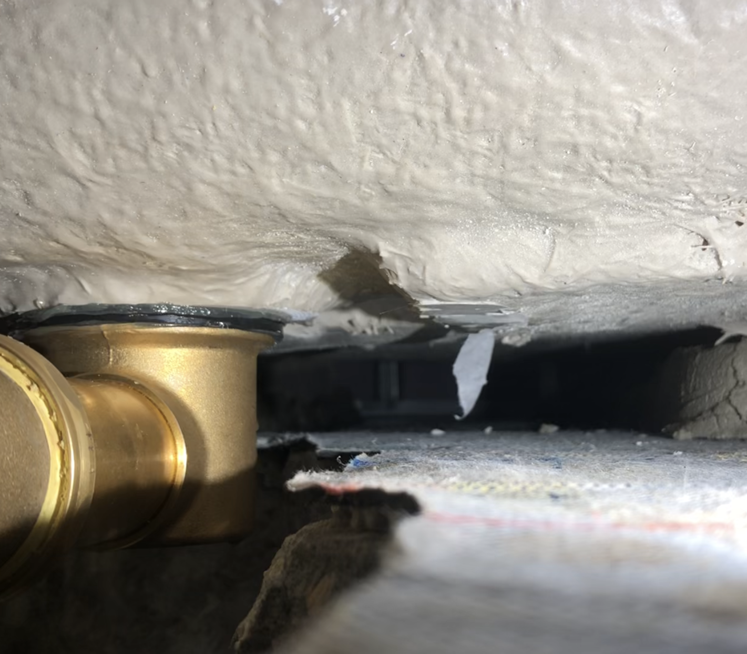
Spark
Scala delta
APIs
SQL magics
Merge
Demo 1
Notebook - DeltaChanges3

Slide 9
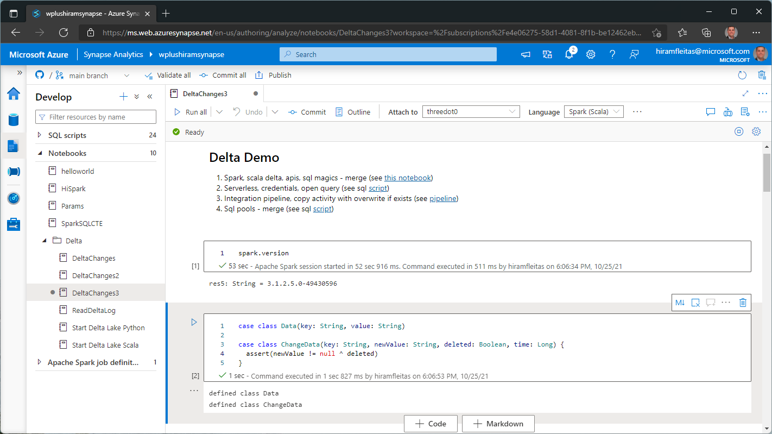

Slide 10
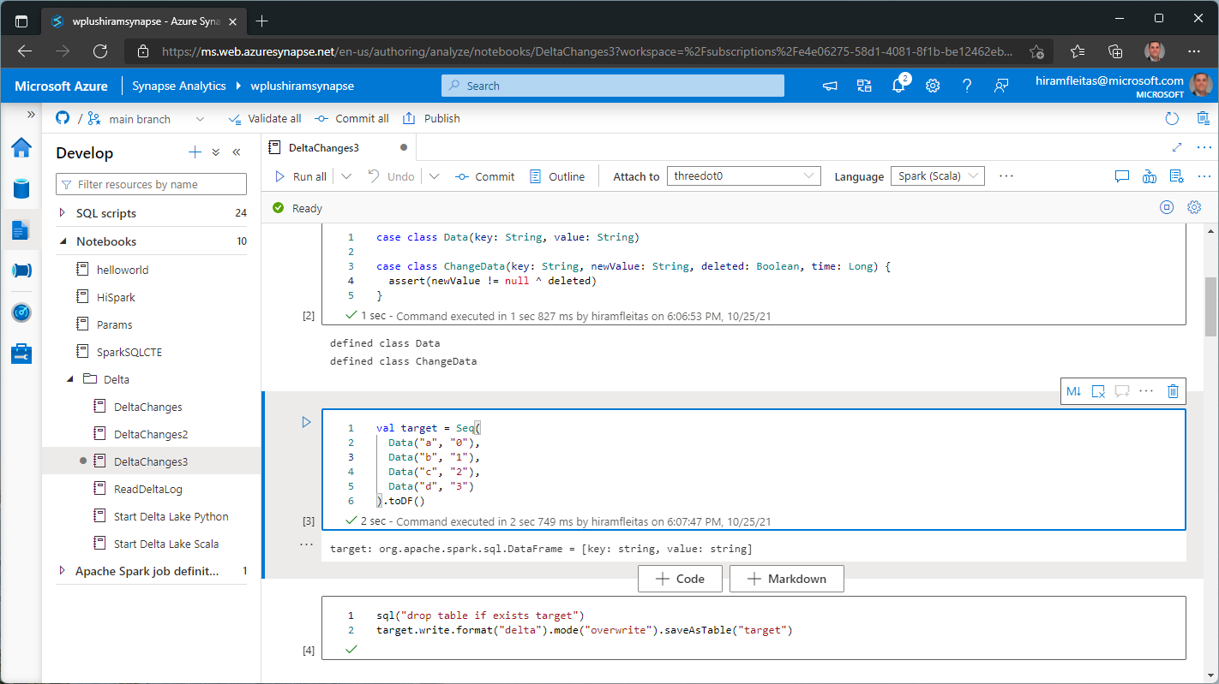

Slide 11
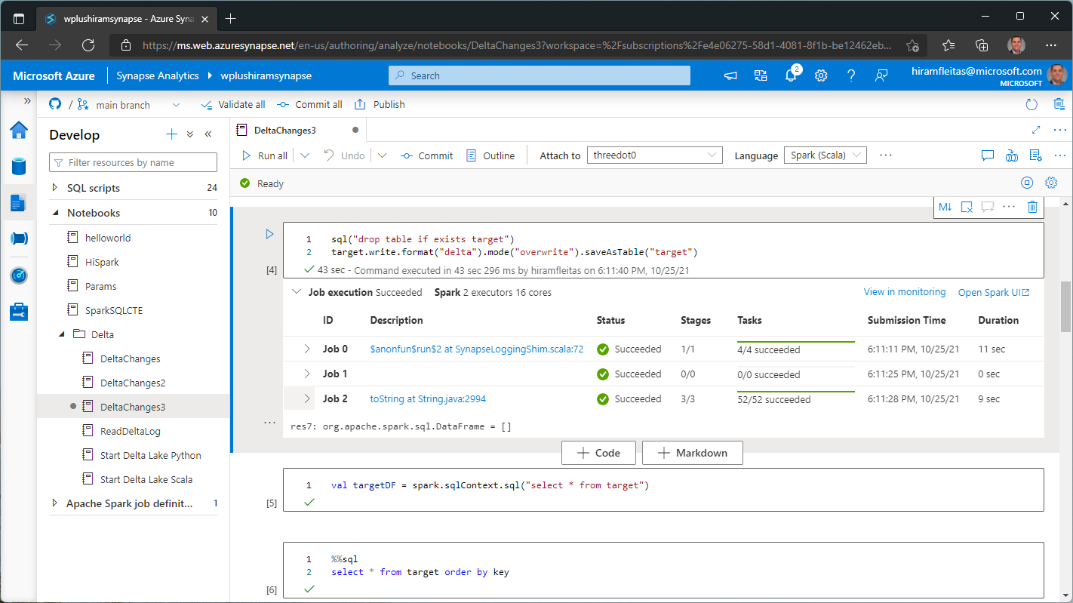

Slide 12
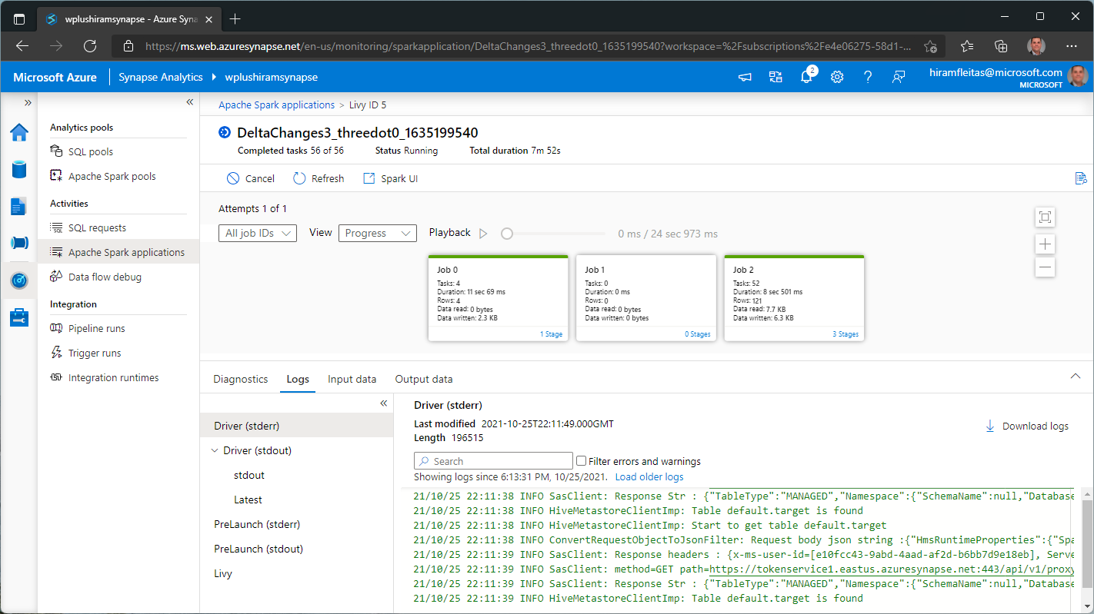

Slide 13
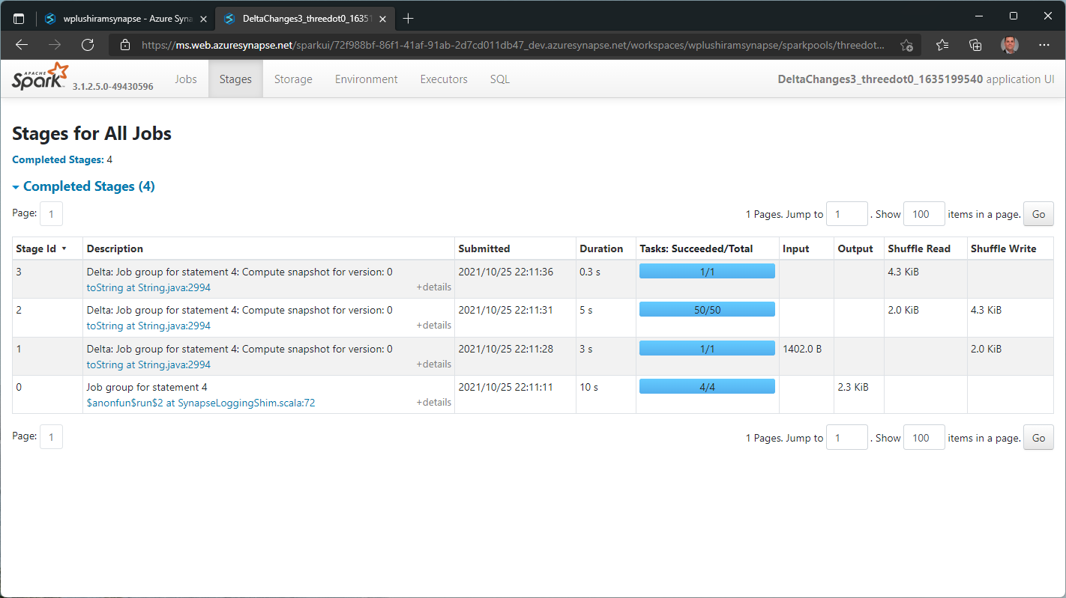

Slide 14
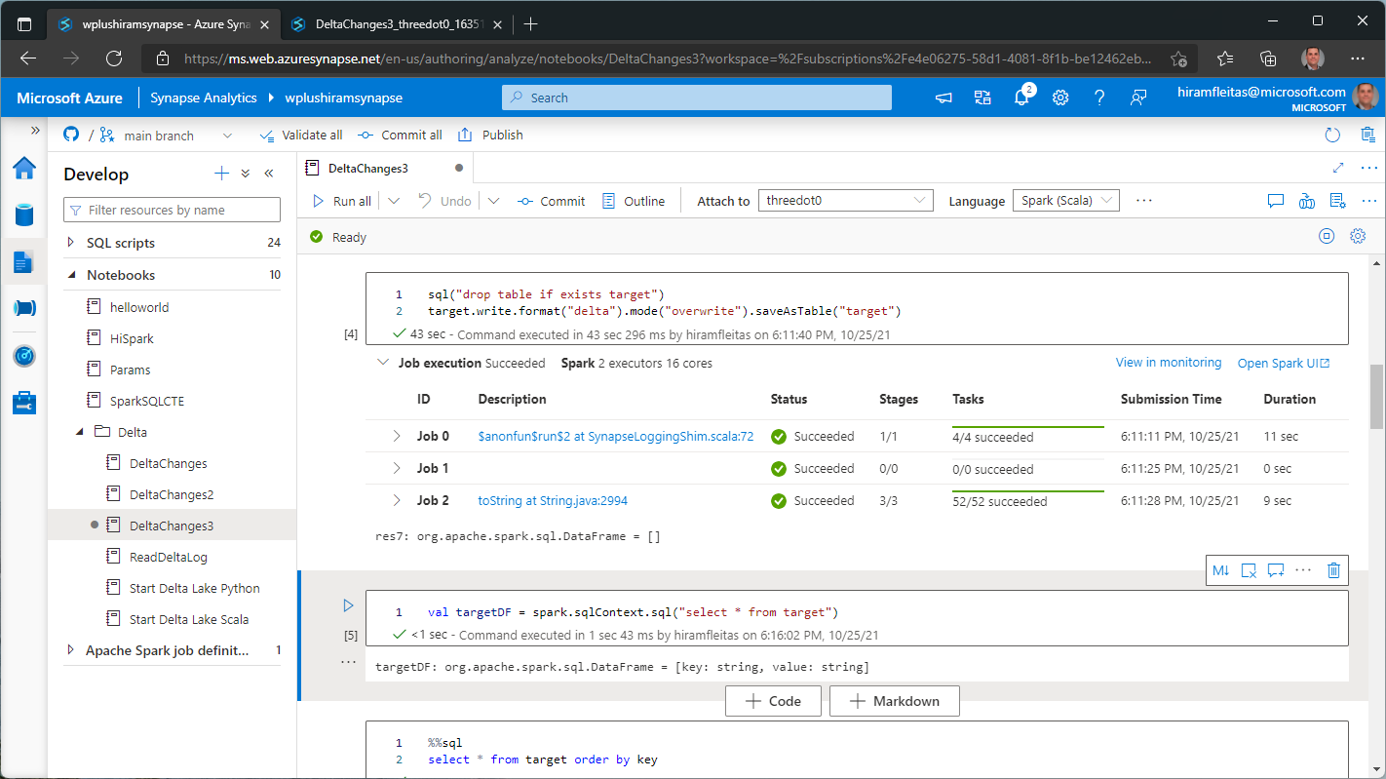

Slide 15
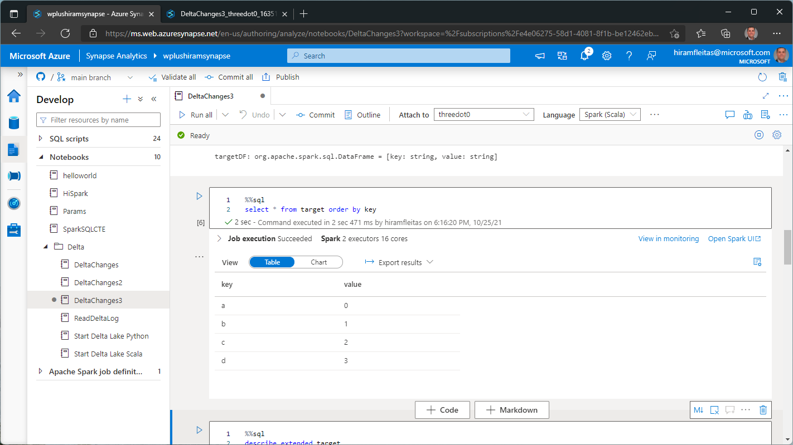

Slide 16
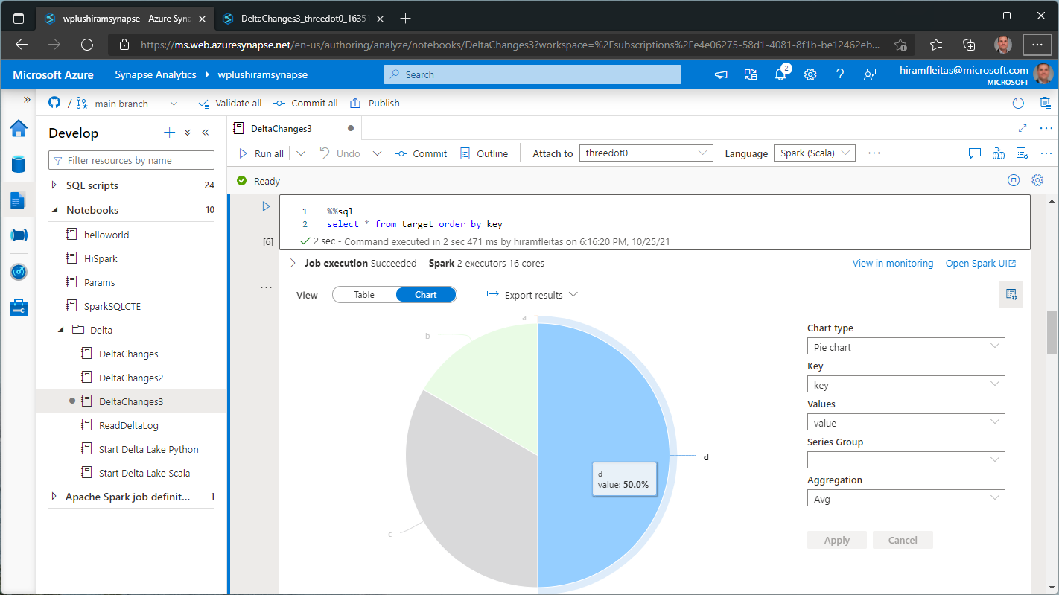

Slide 17
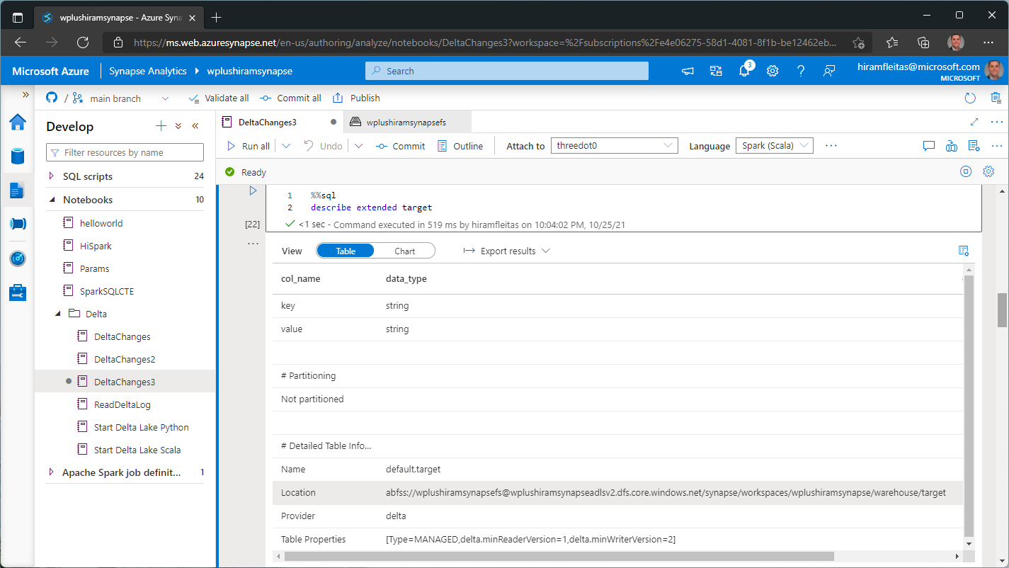

Slide 18
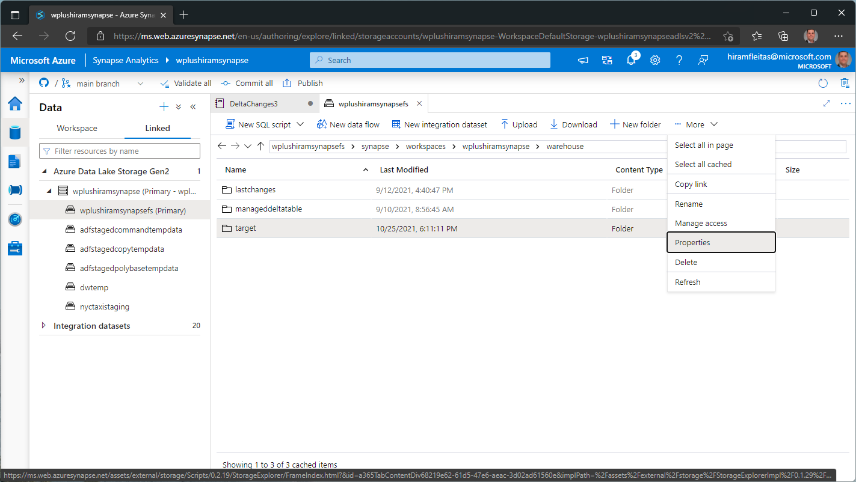

Slide 19
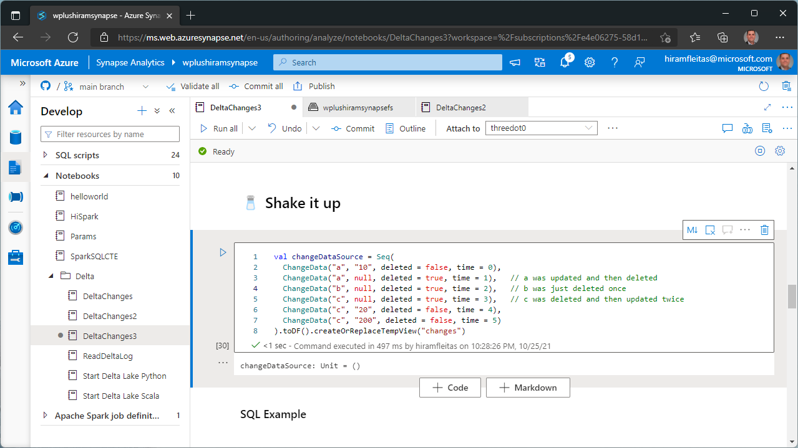

Slide 20
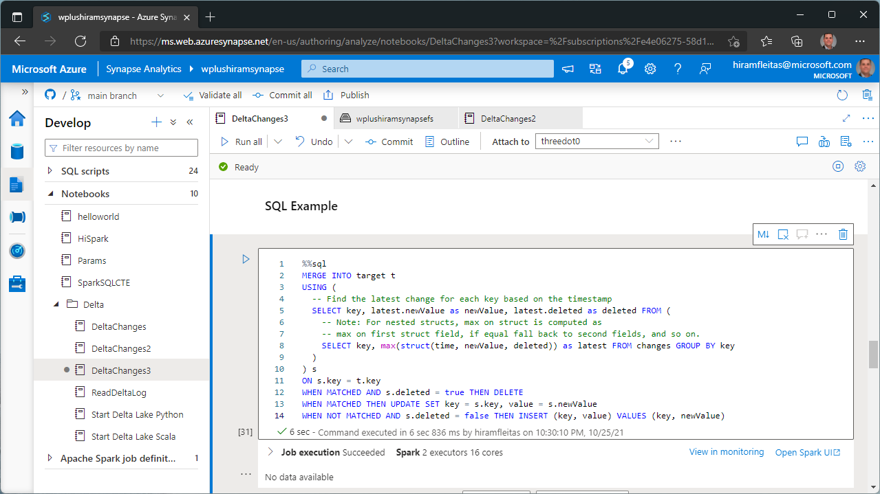

Slide 21
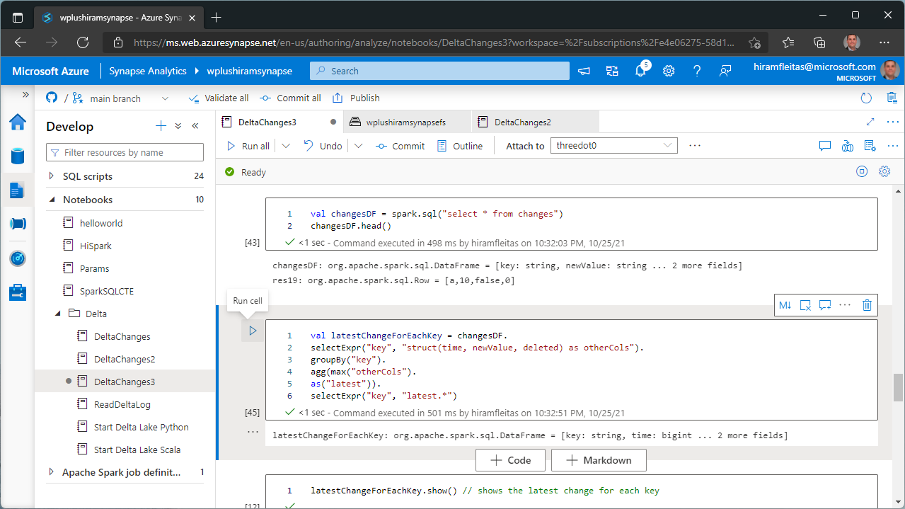

Slide 22
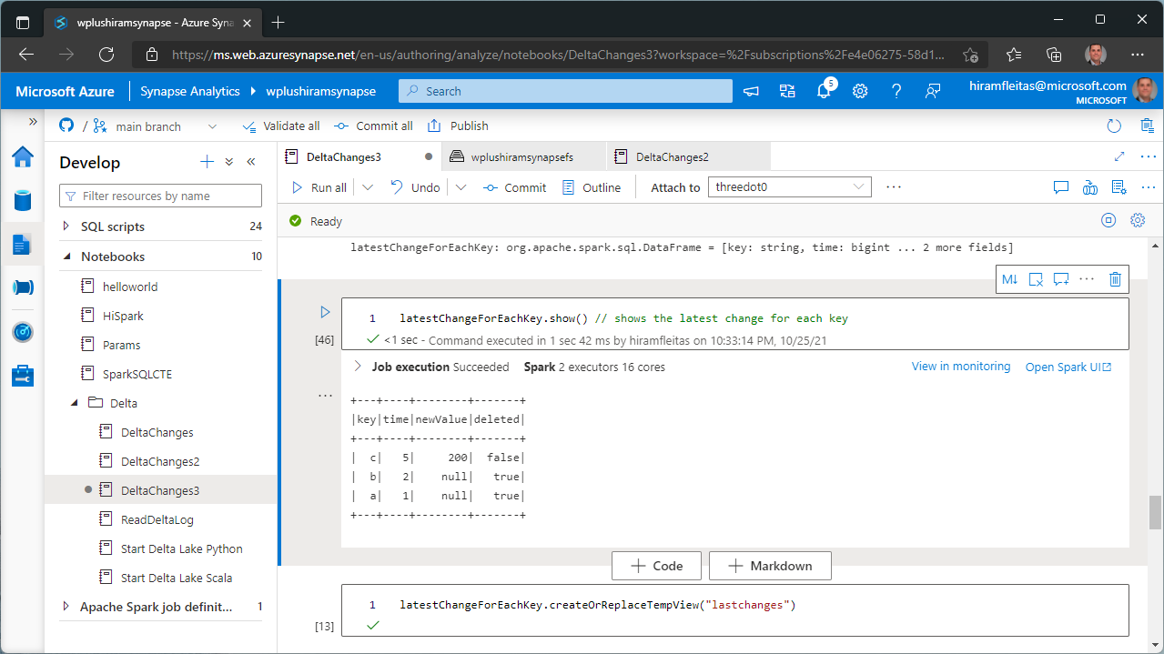

Slide 23
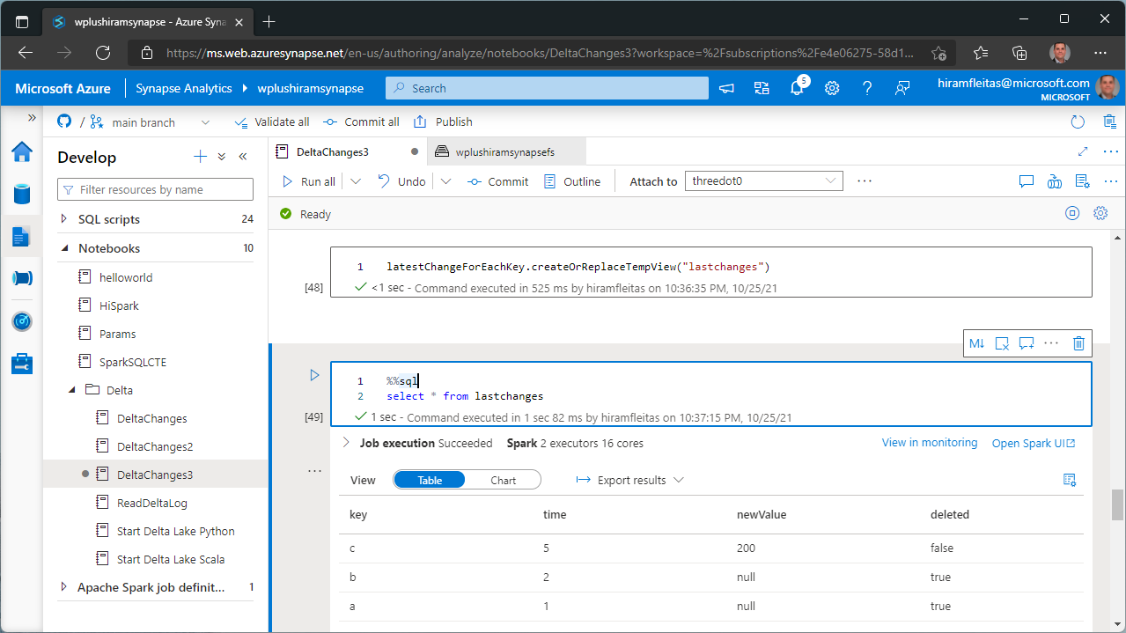

Slide 33
Intro
Spark
Serverless
Pipeline
SQL Pools
Resources
Summary

Slide 34
Resources & Next Steps
github.com/hfleitas/synapsedelta
dba2o.wordpress.com/2021/10/25/synapse-spark-getting-started
github.com/Azure/Test-Drive-Azure-Synapse-with-a-1-click-POC
techcommunity.microsoft.com > Blogs > Azure Synapse Analytics
docs.microsoft.com/azure/synapse-analytics/spark/apache-spark-overview
docs.microsoft.com/azure/synapse-analytics/spark/apache-spark-what-is-delta-lake
docs.microsoft.com/azure/synapse-analytics/spark/synapse-spark-sql-pool-import-export

Slide 35
Eval
bit.ly/sql1021
Your feedback is appreciated.

Slide 36
Thank you
Hiram Fleitas
aka.ms/hiram

